Slide 1
Predicting Sales For Rossmann Drug Stores
SHAMEE MRIMMOAEE AHMED (TP040804)
UC3F1805SE
BSc (Hons) in Software Engineering
Supervised by Dr. MANOJ JAYABALAN
2nd Marker: Dr. KADHAR BATCHA NOWSHATH

Slide 2
Introduction
Rossmann operates over 3,000 drug stores in 7 European countries.
Stores sales are influenced by many factors, including promotions, competition, school and state holidays, seasonality, and locality. Reliable sales forecasts enable store managers to create effective staff schedules that increase product.

Slide 3
Problem Statement
Challenging for the store manager to forecast the right selling history.
Poor Inventory Management.
The Retailer still uses Excel sheet or spreadsheet for tracking their inventory system manually that is one of the biggest mistakes.

Slide 4
Aim
The aim of this project is to develop a decision support system which will predict the sales in six weeks advance for Rossmann Drug Store. A visualization dashboard will be provided which will be showing all the relevant information about the sales of each store.

Slide 5
Objectives
To implement visual analytics for making the data exploration easier.
To identify the significant factor that influences the sales in Rossmann Stores by using feature selection
To develop a single model for predicting the sales of 1,115 Rossmann Drug Stores
To evaluate the predicting model and identify the most accurate model which is suitable for the data sets of Rossmann Drug Stores.

Slide 6
Functionality
To generate a single model which will analyze the sales prediction of 1,115 Rossmann drug stores in six-week advance.
To allow the user a visual interface which will show an important feature that contributes to the sales.
To predict the sales by identifying some trends and pattern in the data.

Slide 7
Technical Research
Python’s pandas and NumPy packages were used for cleaning data and exploratory analysis.
Python’s Scikit-Learn package was used for developing prediction models.
Python XGBoost package was used for developing Xtreme Gradient Boosting models.
Tableau was used for data visualization.

Slide 8
Data Understanding
Data provided by Rossmann as part of a Kaggle competition to predict sales.
Three datasets have been provided a training data, testing data and store data.
Training and testing data contains 1017210 and 41089 records respectively containing historic sales data which is presented store-wise.
Store data contains a lot of supplemental information like store type, assortment level, promos used and competition related data.

Slide 9
Data Preparation
Replacing missing value by imputing zero, one and the mean value of the variables.
Outlier Detection by plotting histogram and boxplots
Converting Categorical to Numerical variables by using One-Hot encoding.
Data Integrated by merging the train and store dataset.
Log transformation is applied to the right skewed data.

Slide 10
Data Exploration
Univariate Analysis
Bivariate Analysis
Multivariate Analysis
Interactive Dashboard

Slide 11
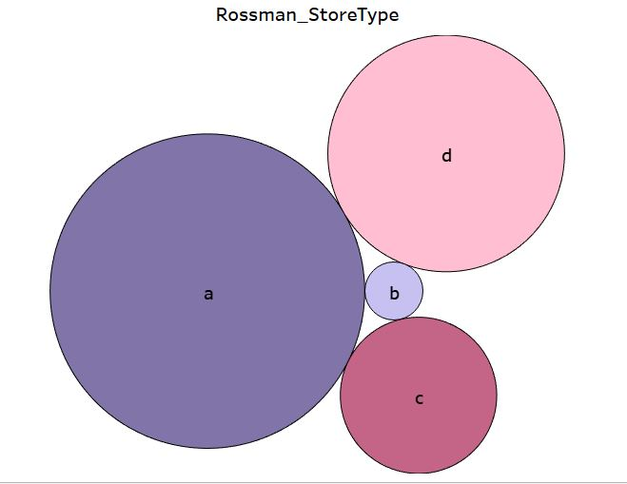
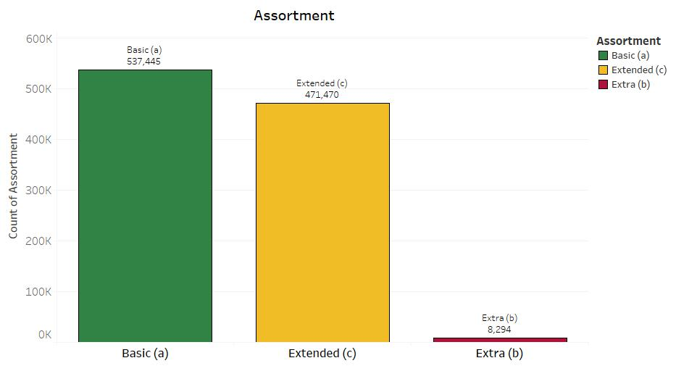
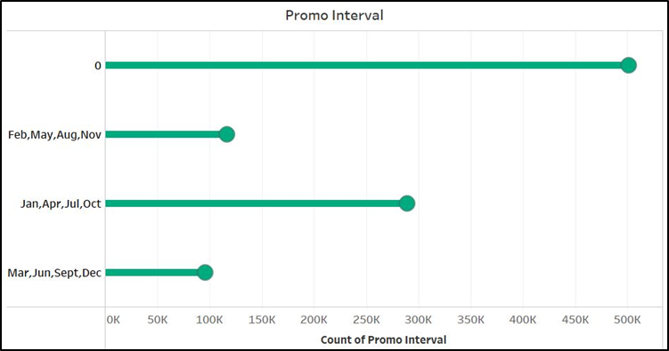
Univariate Analysis

Slide 12
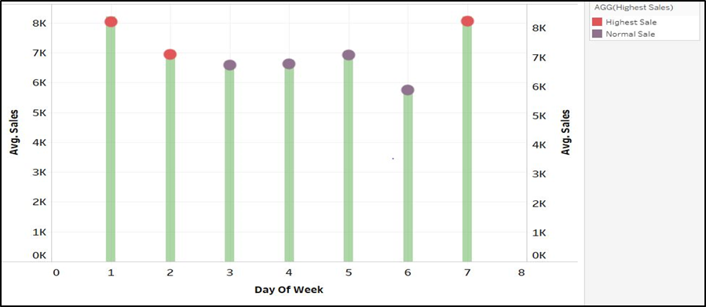
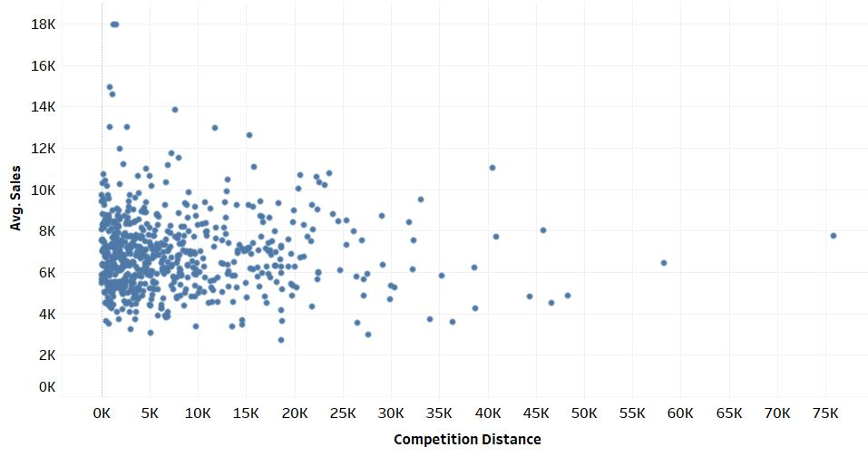
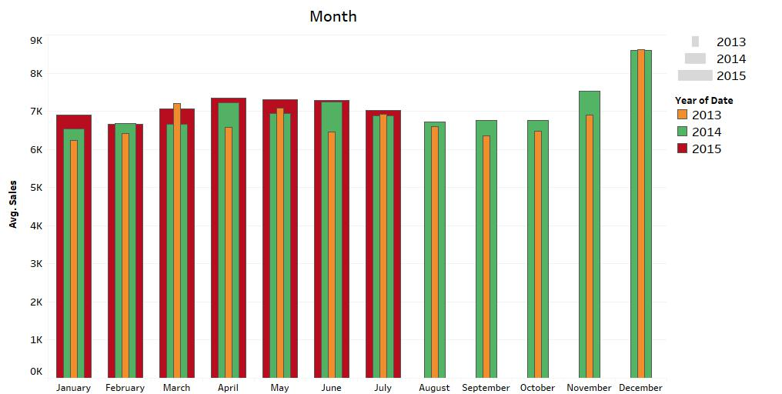
Bivariate Analysis

Slide 13
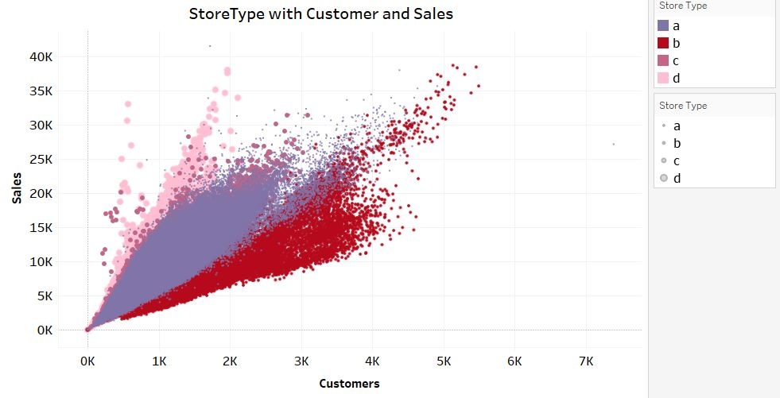
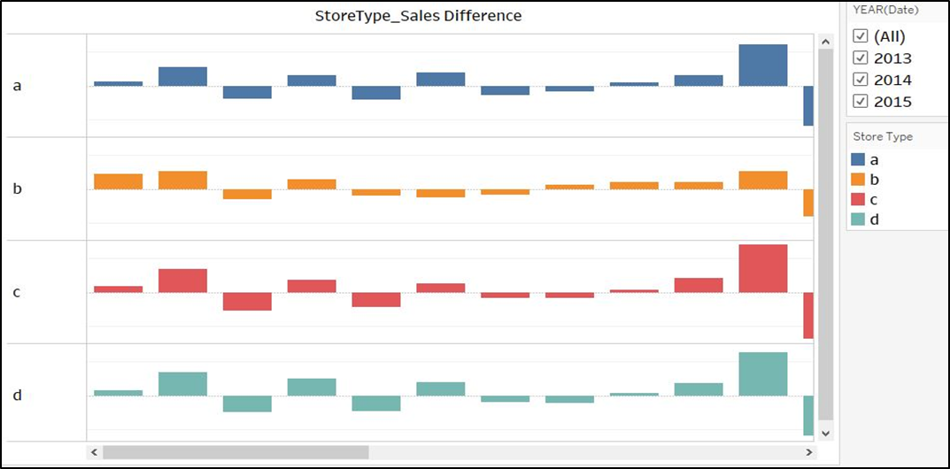
Multivariate Analysis

Slide 14
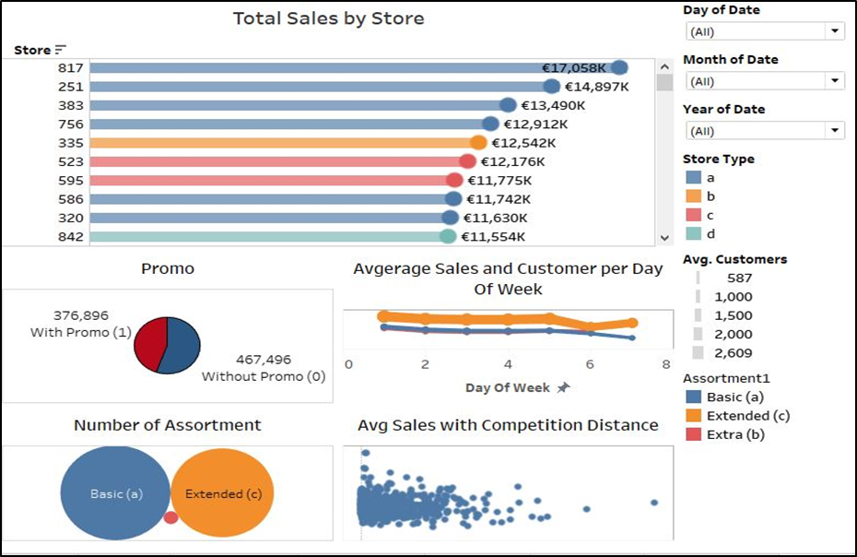
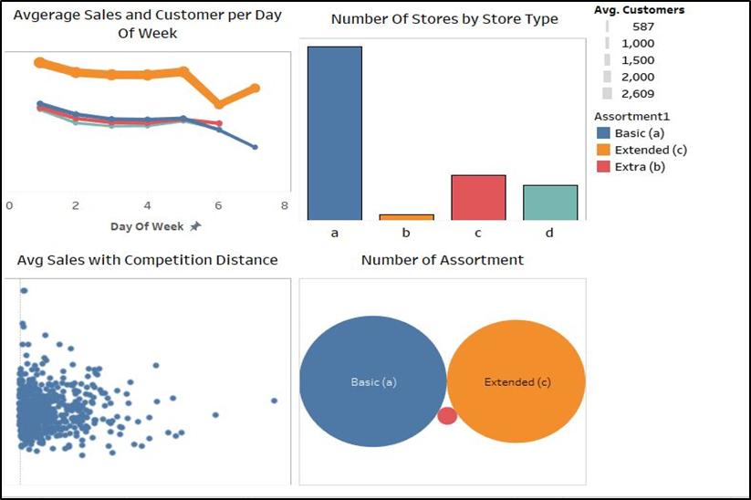
Interactive Dashboard

Slide 15
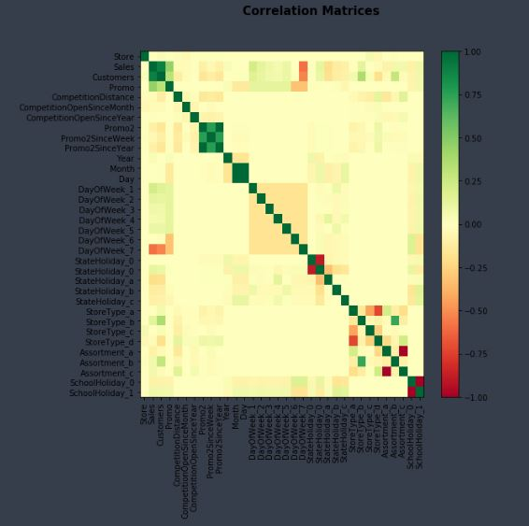
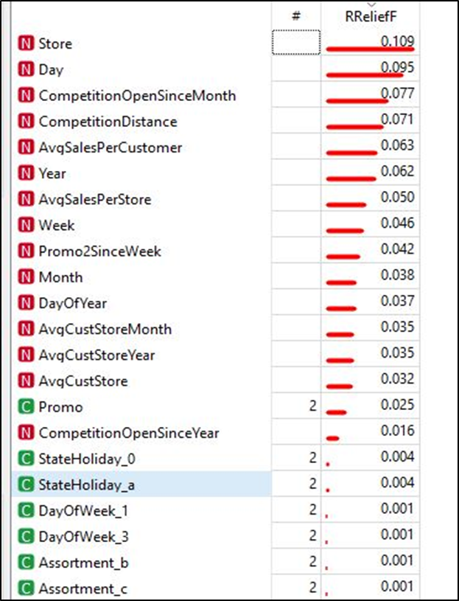
Feature Selection
Correlation Analysis
Relief

Slide 16
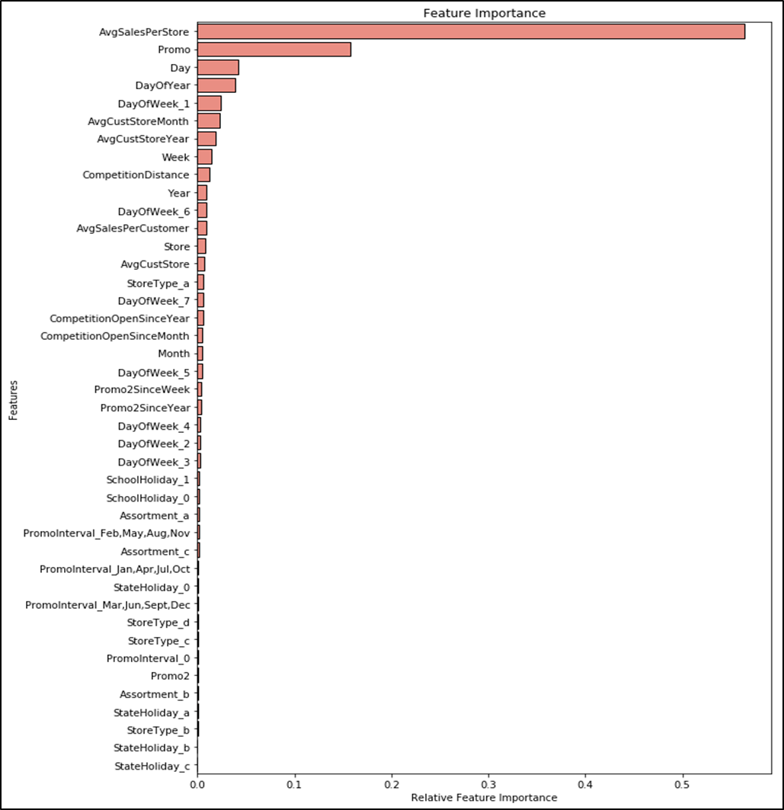
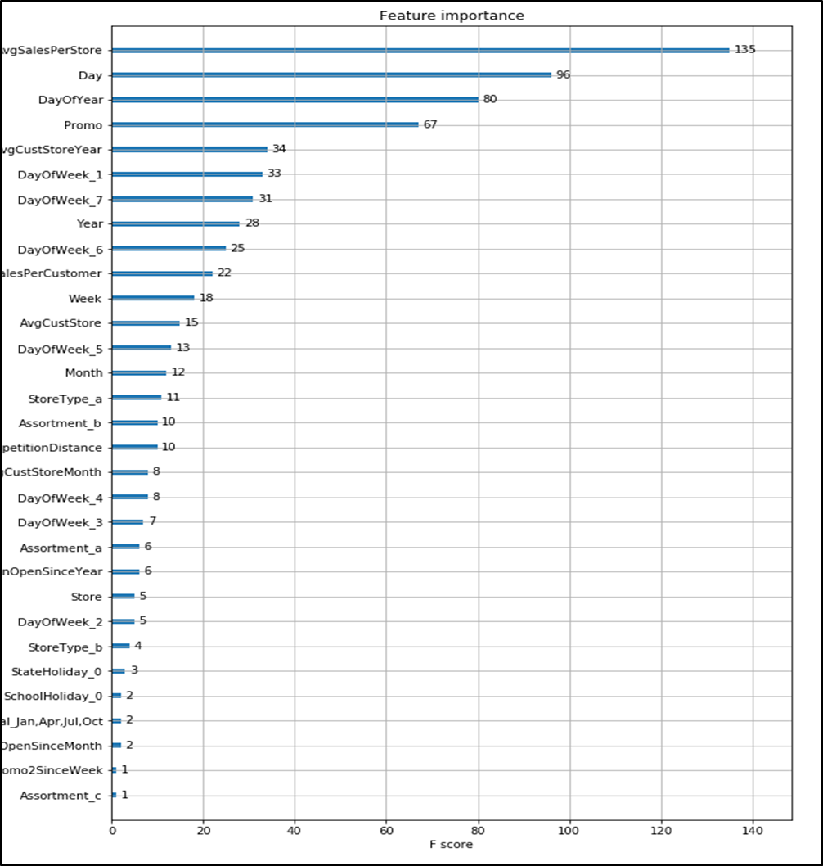
Feature Selection
Random Forest Regressor
Xtreme Gradient Boosting

Slide 17
Modelling
Linear Regression
Random Forest Regression
Xtreme Gradient Boosting (XGB)

Slide 18

Evaluation
Results were evaluated by using the Root Mean Square Percentage Error (RMSPE). The RMSPE is calculated as:
Where yi represents the sales of a single store on a particular day and the symbol ŷ​i represent the corresponding​ ​prediction. ​This equation ignores the value of 0 sales and the closed stores.

Slide 19
Best Model
Model | Feature Selection | RMSPE
Linear Regression | Random Forest | 0.2348
Random Forest Regression (100 trees) | XGBoost | 0.1193
Xtreme Gradient Boosting (1000 trees) | Random Forest | 0.0999

Slide 20
THANK YOU

